Slide 1



SAVEETHA INSTITUTE OF MEDICAL AND TECHNICAL SCIENCES
Capstone project presentation
IoT-Integrated Control System for Actuators and Lighting using ESP32 Microcontroller
CSA4101 – Internet of Things for Beginners
Guided By :
Dr. B. Prabakaran &
Dr. Geetha R
Presented by:
HARI PRASAD L S
(192413023)

Slide 2




INTRODUCTION
Internet of Things (IoT) enables smart control of devices over the internet.
Home automation is one of the most important applications of IoT.
This project demonstrates a smart system to control a light and a motor using:
  Web interface
  Voice commands
The system is implemented using an ESP32 microcontroller.

Slide 3

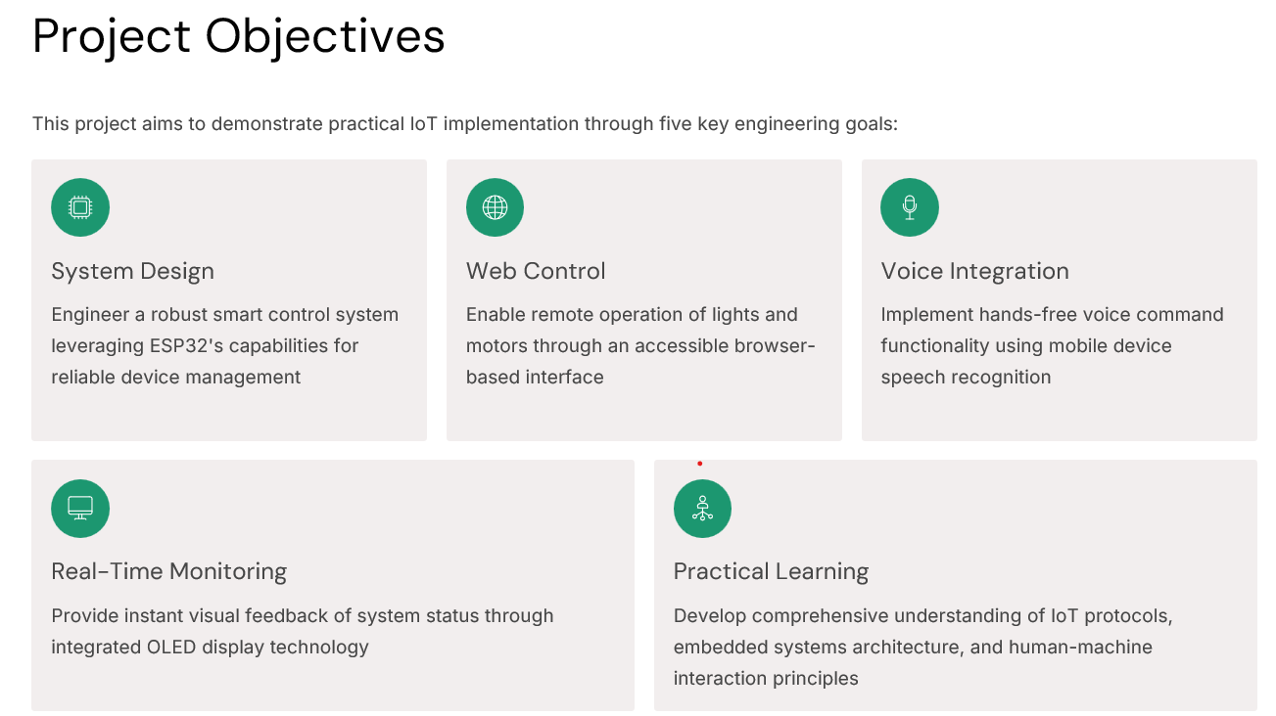
PROJECT OBJECTIVE

Slide 4
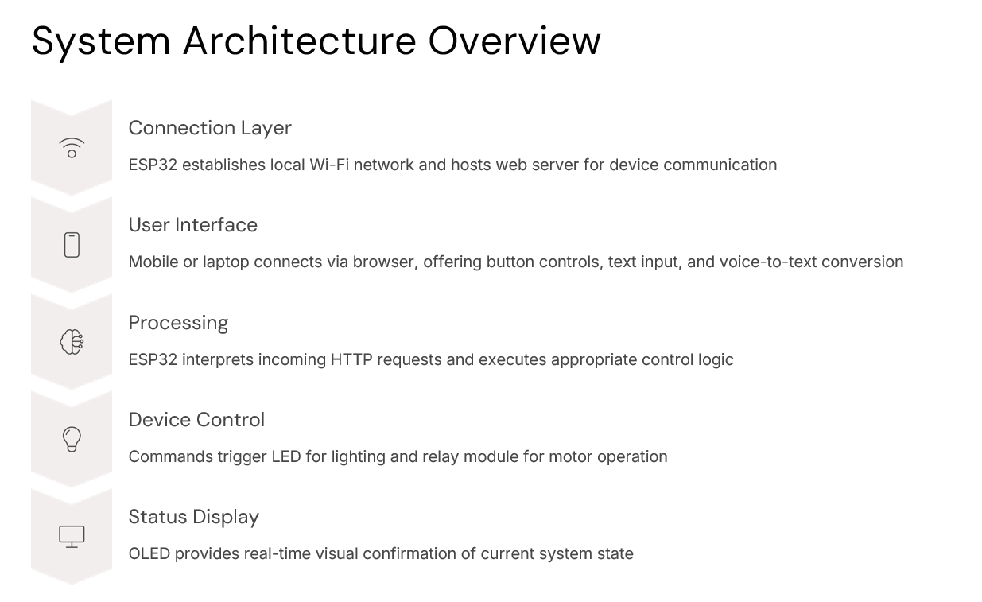
SYSTEM ARCHITECTURE OVERVIEW

Slide 5
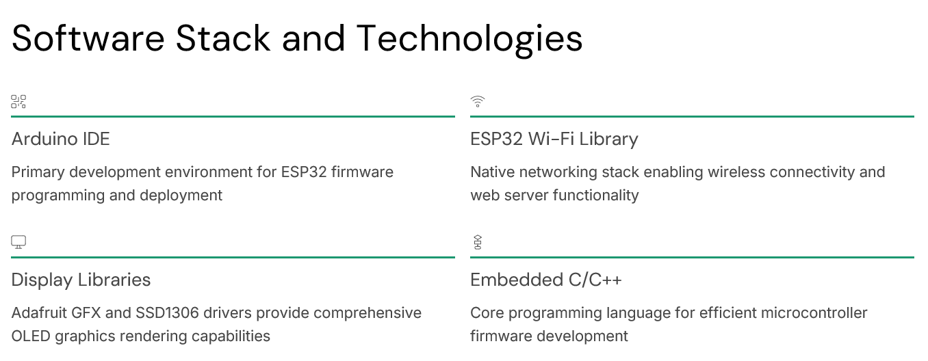
SOFTWARE STACK AND TECHNOLOGIES

Slide 6
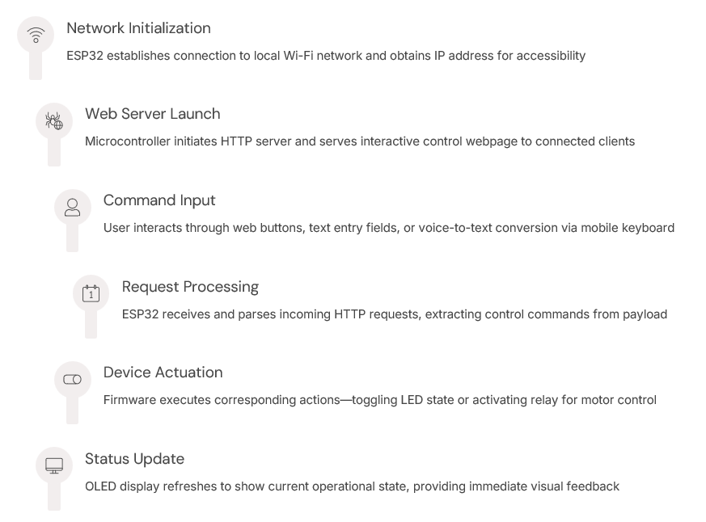
SYSTEM WORKING PRINCIPAL

Slide 7
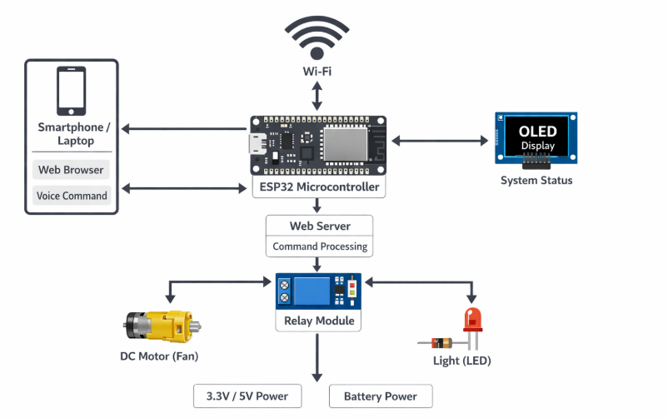
SYSTEM DESIGN/ BLOCK DIAGRAM

Slide 8
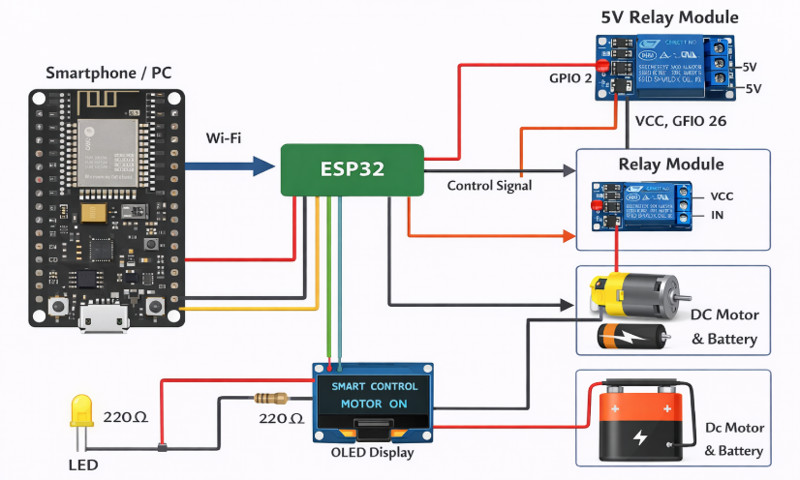
CIRCUIT DIAGRAM

Slide 9
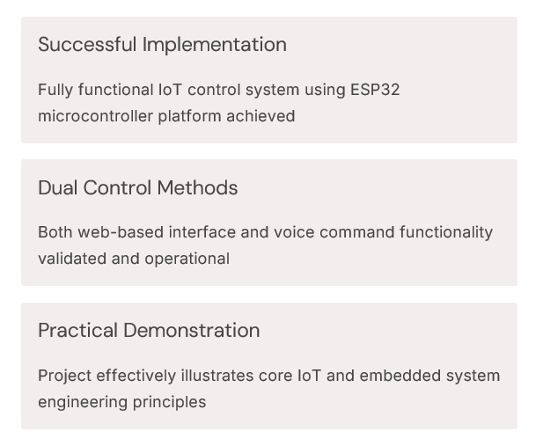

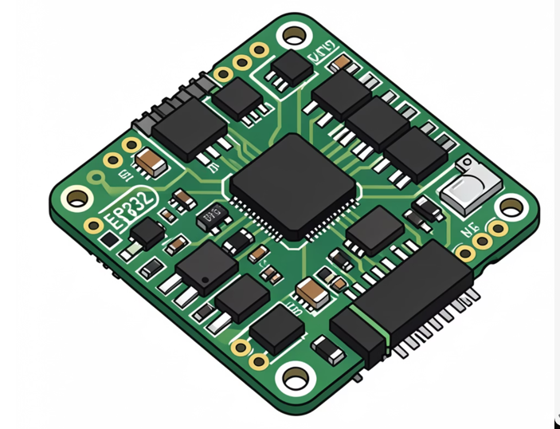
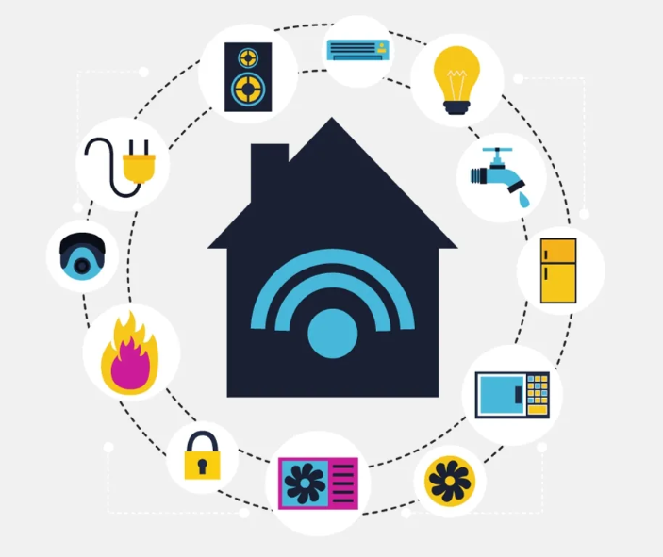
CONCLUSION & FUTURE SCOPE

Slide 10


